Slide 1
Determining Sentiment for Drug Reviews
Mehmet Erdoğdu

Slide 2
Overview
Companies are constantly looking out across Blogs, Forums, and other social media platforms, etc. to check sentiment for their various products (as well as competitor’s products) to learn how their brand resonates in the market.
Many symptoms and side effects of drugs are hidden within online reviews, which can be harnessed to improve both the drugs themselves and the effectiveness of their prescription.
This is all essential information for pharmaceutical companies and medical institutions.

Slide 3
Investigating the Data
I have used UCI Machine Learning - Drug Review Dataset. I acquired the data set through Kaggle website, which can be found at this link:
https://www.kaggle.com/jessicali9530/kuc-hackathon-winter-2018
The dataset has 7 columns with a total 161297 entries.The column names as follows:
uniqueID:Unique ID
drugName:Name of drug
condition:Name of condition
review:Patient review
rating:10 star patient rating
date:Date of review entry
usefulCount:Number of users who found review useful

Slide 4
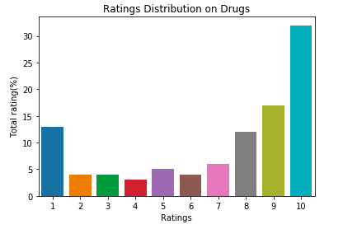
Exploratory Data Analysis
Each review entry has the text of the review along with the user rating on a scale of 1-10.
We can see the distribution of the different ratings on the chart.
10 is the most common rating by reviewers with more than 50% of the all reviews, with 4 being the least common

Slide 5
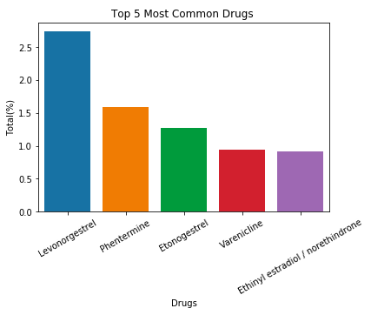
There are 3436 unique drug names in the data set.
Levonorgestrel is the most common drug reviewed in the dataset.
The chart shows the top 5 most common drug names.

Slide 6
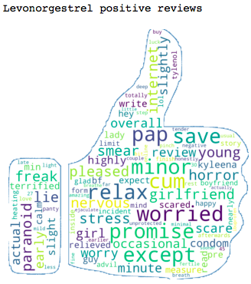
The most common drug in the dataset is Levonorgestrel, which is a form of birth control.
The chart shows the 100 most predictive words for positive sentiment for this drug.
For positive sentiment 'worried', 'minor', 'except', 'pap', 'cum', 'relax', 'promise', 'save', 'girlfriend', 'lie' are most probable.

Slide 7
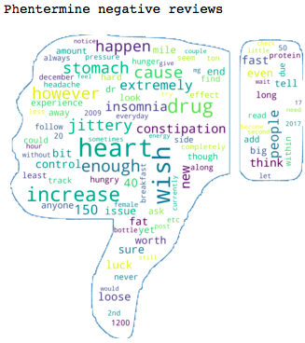
The chart shows the 100 most predictive words for negative sentiment for this drug.
For negative sentiment 'remove', 'ultrasound', 'hair', 'constantly', 'cyst', 'surgery', 'depression', 'constant', 'infection', 'clot' are most probable.

Slide 8
Machine Learning
I began by doing an 80/20 split for my train and test sets - the test set remained untouched until the final model was selected and tuned.
I then used a Pipeline object to chain estimators so I could gridsearch not only the parameters of the models but also for CountVectorizer and TFIDFVectorizer to optimize for minimum document frequency and maximum document frequency.
I used balanced accuracy as my metric to determine the best parameters for each model, grid searching over 5-fold cross-validation.

Slide 9
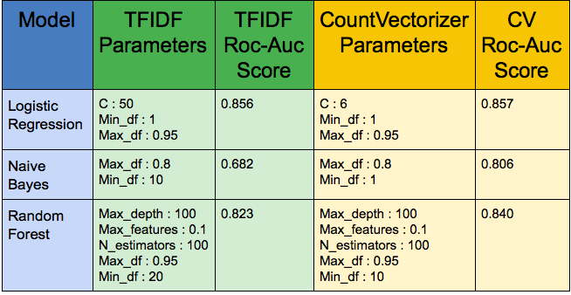
Machine Learning

Slide 10
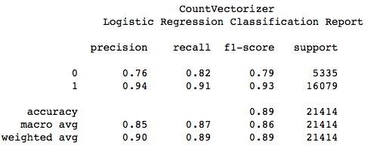
First used Countvectorizer to both tokenize the collection of reviews and build a vocabulary of known words, and then encode new documents using that vocabulary.
Performed gridsearch for maximum documentation frequency and received the same score as 0.95 so assumed maximum documentation frequency as 0.95 for all models.

Slide 11
Conclusions
After building and testing over 3 models with 2 separate vectorizer, I concluded that
Logistic regression has the highest accuracy score with 0.857 with 6% False Positive rate for Countvectorizer and 0.856 with 6% False Positive rate for TFIDFvectorizer.
While drug companies get feedback from clinical trials in the development of their products, these are limited in size and scope and online reviews can offer an important next level of feedback on a wider scale. Drug companies may consider modifying drugs based on customer reviews for the next generation production phase. They can keep the positive features based on positive reviews. They can also focus on customer complaints and can make changes to drugs based on negative reviews. This will help the companies produce better products and solve the health issues of customers more efficiently.

